Slide 1

The Finance Minister’s proposed
2026-27 to 2028-29/29-30 Budget
Sir Robert Chote
24 February 2026

Slide 2

Outline
The scope of the NI Budget
Recent developments
Overspending and pay pressures
The funding outlook: block grant and rates flat
Budget allocations and bids
Next steps in Budget process
Summary and reflections: impact of bailouts on balance/sustainability

Slide 3
The scope of the Executive Budget
Day-to-day resource spending (c £16.5bn in 2026-27)
  Covers public services, administration and debt interest
  Financed from Block Grant, Rates and (less visibly) fees and charges and EU
Conventional capital spending (c.£2.3bn in 2026-27)
  Covers infrastructure, building, plant and machinery
  Financed from Block Grant, borrowing and Irish Government A5 contribution
Financial Transactions Capital spending (c. £60m)
  Confined to loans to or equity stakes in private sector entities
  Financed from Block Grant
The Budget for each category must ‘balance’

Slide 4
Recent developments
Multi-year UK Spending Review and Stormont is sitting – so conditions are in place for first multi-year Budget since 2011-12 to 2014-25
But the Executive failed to agree one. So, the Finance Minister has published a broadly-neutral proposal for consultation – no major strategic/political reallocations. But the other parties inside and outside the Executive have already rejected it
Meanwhile NI Departments have been overspending their budgets again this year, largely because of pay pressures (tension between parity and affordability)
UK Treasury has a agreed a loan to cover most of this year’s overspend, repayable over three years rather than the usual one

Slide 5
Overspending again in 2025-26
Departments have tended to overspend since 2022-23
Health (£212m) and Education (£231m) are together forecast to overspend by £457m this year on resource (day-to-day) spending
Treasury has agreed a £400m Reserve claim to cover 90% of this, to be repaid £80m, £160m, £160m over next three years
Budget will balance this year if the Executive can deal with the remainder and any net pressures from other departments

Slide 6
The impact of pay pressures
Overspend this year largely driven by matching UK Govt pay deals
In early November – with its budget already on course to overspend – the Executive agreed to pay review recommendations for Health. This required a Ministerial direction: “Officials advised that the application of these recommended awards is not currently affordable”
Executive also approved teachers’ pay award, again with the NICS requiring a Ministerial Direction as unaffordable within budget
NI relies more on Ministerial Directions than Scotland or Wales

Slide 7
Pay is a structural problem
When the UK Government agrees an x per cent increase in public-sector pay in England, the Block Grant does not rise enough to match this in NI under the Barnett Formula – even with the new 24% top-up
Affordability issue arises when there are more than 24% more employees

Slide 8
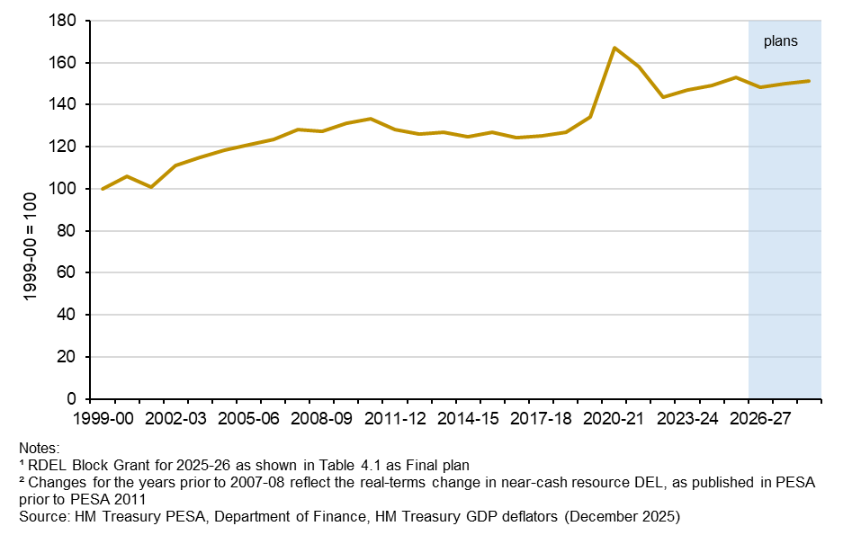
Real funding broadly flat: block grant

Slide 9
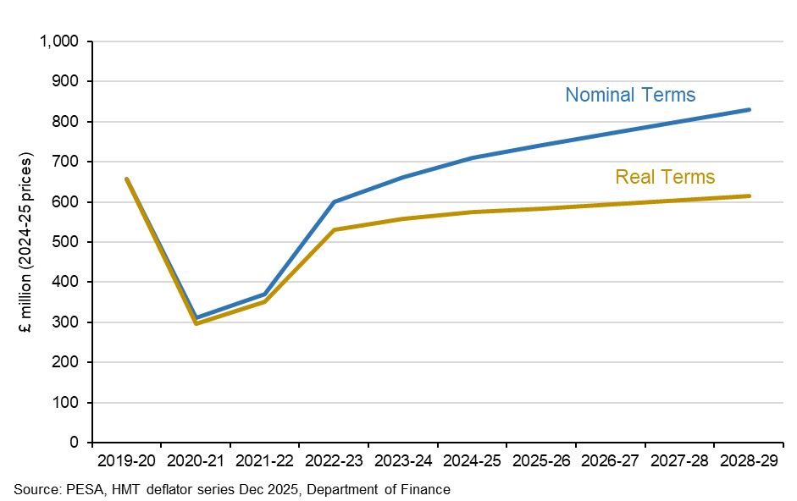
Real funding broadly flat: regional rates

Slide 10
But overspending increases volatility

Slide 11
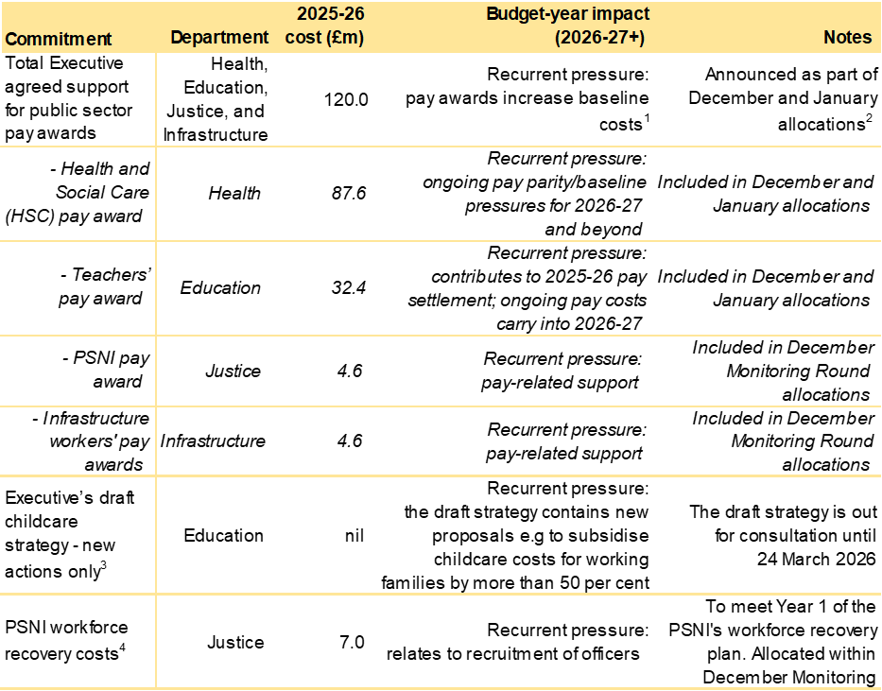
Commitments compound 26-27 cliff edge

Slide 12
Resource budget broadly neutral

Slide 13
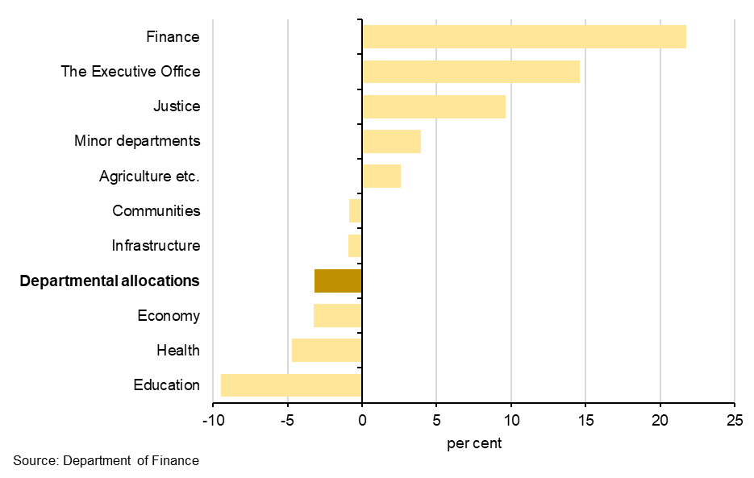
Over-spenders see budgets fall next year
2026-27 resource budget vs 2025-26 final plans
Note:
Health and Education are shown with overspend recovery deducted from 26-27

Slide 14
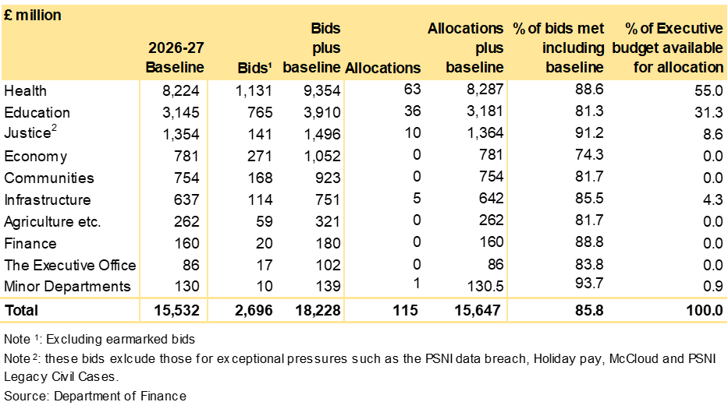
Allocations as usual fall short of bids

Slide 15
Same true for capital spending

Slide 16
Next steps
Finance Minister will need to produce revised proposal after consultation
Timetable currently allows for the process to conclude by end March.
But will the Executive be able to agree one with election looming? The proposed Budget is already pretty neutral politically/departmentally
As usual, Vote on Account allows departments to continue spending
Relatively weak link to PfG remains and no ISNI yet published

Slide 17
Summary and reflections I
Treasury loan covers 90% of this year’s projected resource overspend, bringing budget closer to balance for 2025-26
The Finance Minister’s proposed Budget for the next three years balanced ex ante, but savings needed now for overspend recovery: now that position is effectively imbalance
Funding was reasonably flat in real terms but overspend and repayment means real spending falls next year, especially in Health and Education
Balancing the Budget in 26-27 also complicated by earlier Executive commitments involving spending that year (mostly pay again) raising questions of credibility

Slide 18
Summary and reflections II
Extended Treasury loan terms relieve spending pressure next year with few strings
But does this normalise “serious financial management” and leave parties anticipating more help if needed – especially with election looming?
Recent de facto bailouts may have eased pressure on Executive to consider pay parity, levels of relative public sector employment and potential revenue raising
Treasury may see open book review as chance to identify savings; Executive may see it is an opportunity to re-open needs discussion and claim underfunding
Hard to be confident in agreement and delivery of robust three-year Budget

